Slide 1
Ch2(2.1~2.4),likelihood
2022/08/14
양준영, 양동현, 문상원

Slide 2
Real dataset
• Popular open data repositories
— UC Irvine Machine Learning Repository
— Kaggle datasets
— Amazon’s AWS datasets
• Meta portals (they list open data repositories)
— Data Portals
— OpenDataMonitor
— Quandl
• Other pages listing many popular open data repositories
— Wikipedia’s list of Machine Learning datasets
— Quora.com
— The datasets subreddit

Slide 3
Ⅰ. | Objective
Ⅱ. | Get data
Ⅲ. | Test set
Ⅳ. | Visualize

Slide 4
Objective
Objective
->what model?
prediction of a district’s median housing price
->use the California Housing Prices dataset(based on 1990 Califonia census
->multivariate regression

Slide 5

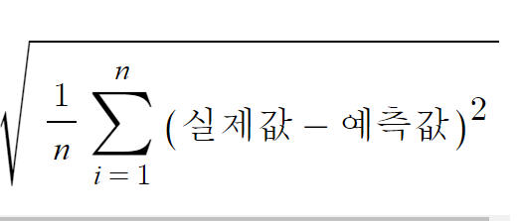

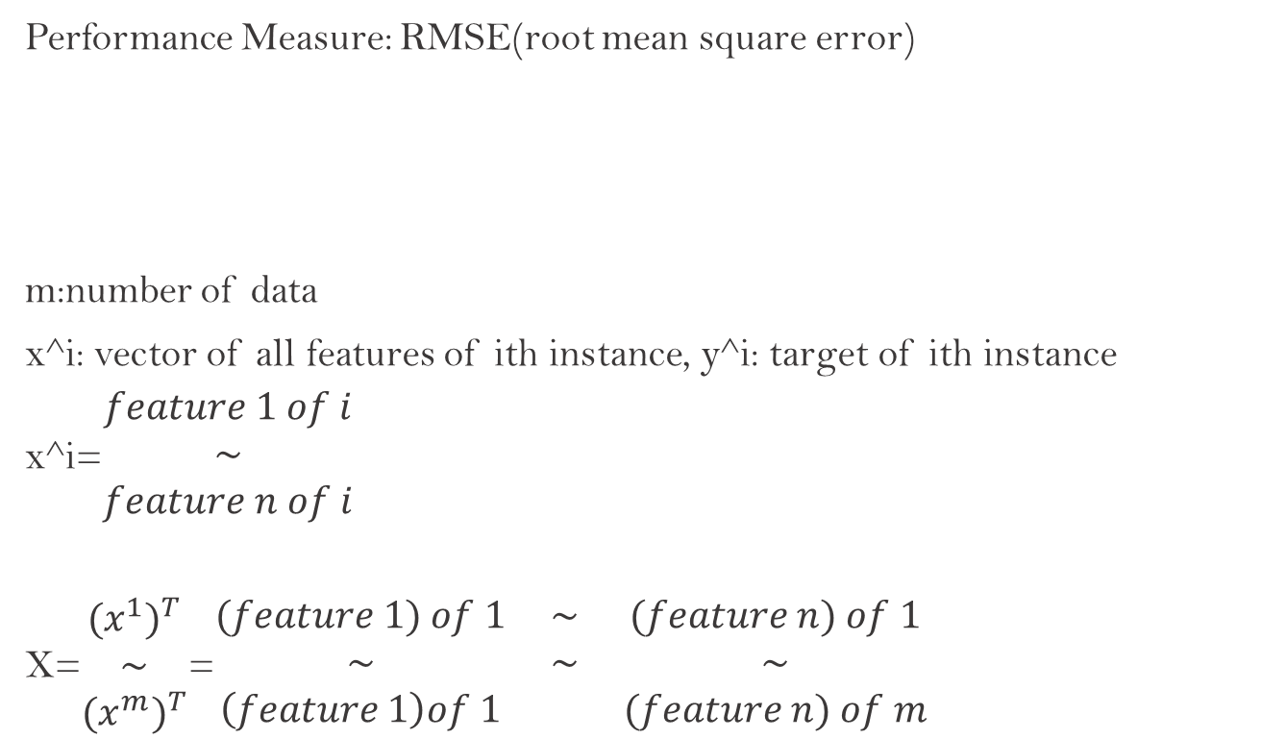
Objective
Performance Measure: RMSE(root mean square error)
m:number of data
x^i: vector of all features of ith instance, y^i: target of ith instance
x^i=$\begin{matrix}feature 1 of i \\ \sim \\ feature n of i\end{matrix}$
X=$\begin{matrix}{(x^{1})}^{T} \\ \sim \\ {(x^{m})}^{T}\end{matrix}$=$\begin{matrix}(feature 1) of 1 & \sim & (feature n) of 1 \\ \sim & \sim & \sim \\ \left(feature 1\right)of 1 & & (feature n) of m\end{matrix}$
MAE(mean absolute error)

Slide 6
Get data
Get data from https://github.com/ageron/handson-ml2
->housing.csv->ctr s
Or
Use web browser to download
-code in hands on machinlearning textbook
Look data structure
head(): look top 5 rows
info(): quick description of data(number of rows, attribute’s type, nonnull number
describe(): summary of numerical attributes(count, mean, min, max~)
hist():plot histogram of attribute

Slide 7
Test set
Create a Test Set(20% of data)
Random sampling
-pick instances randomly(use if data is large enough)
Stratified sampling
-make test set represent overall data, more unbiased
*Assume median income important
-> pd.cut() function, categorize data with income

Slide 8
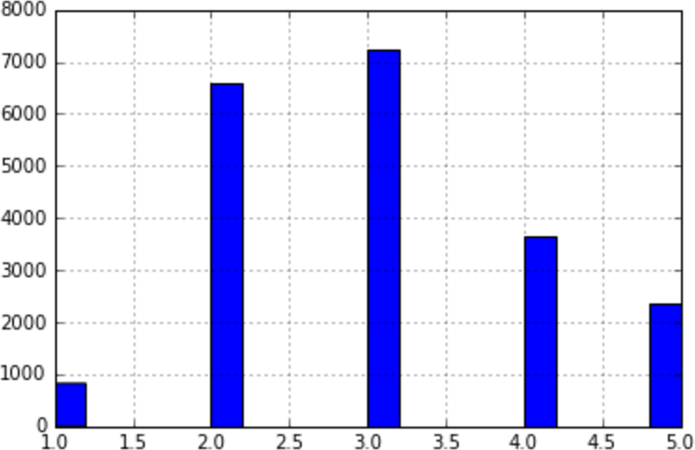
Test set
Histogram of income categories
Get test data from each income

Slide 9
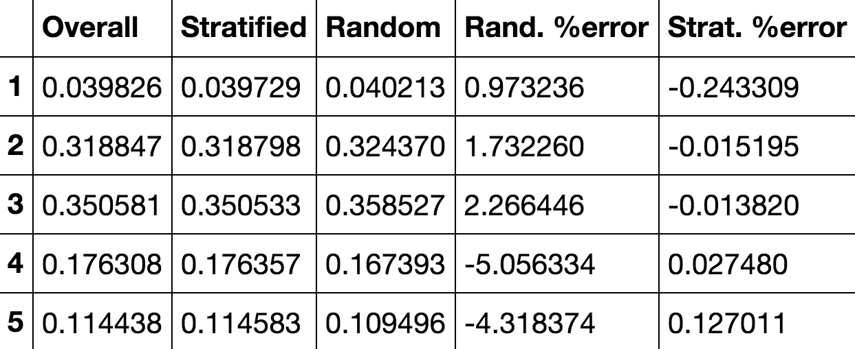
Test set
Random sampling(skewed) vs stratified sampling(identical)

Slide 10
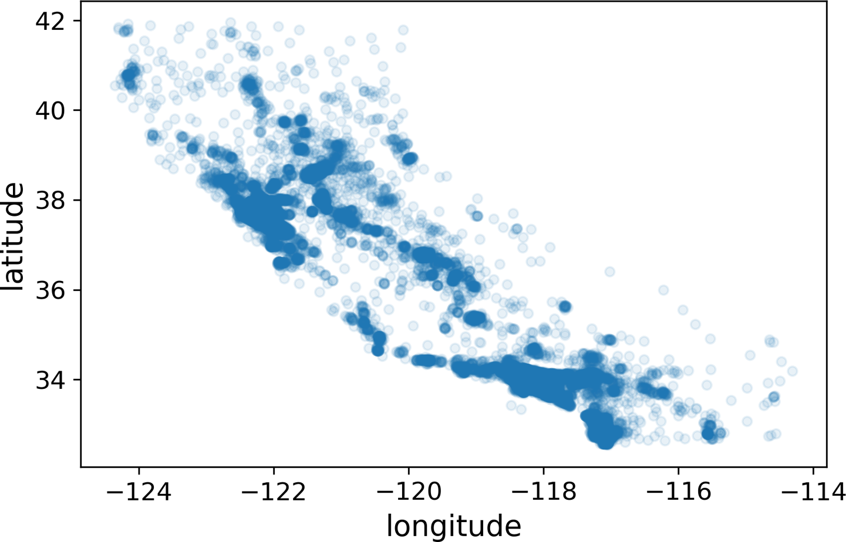
visualize
housing.plot(kind="scatter", x="longitude", y="latitude", alpha=0.1)

Slide 11
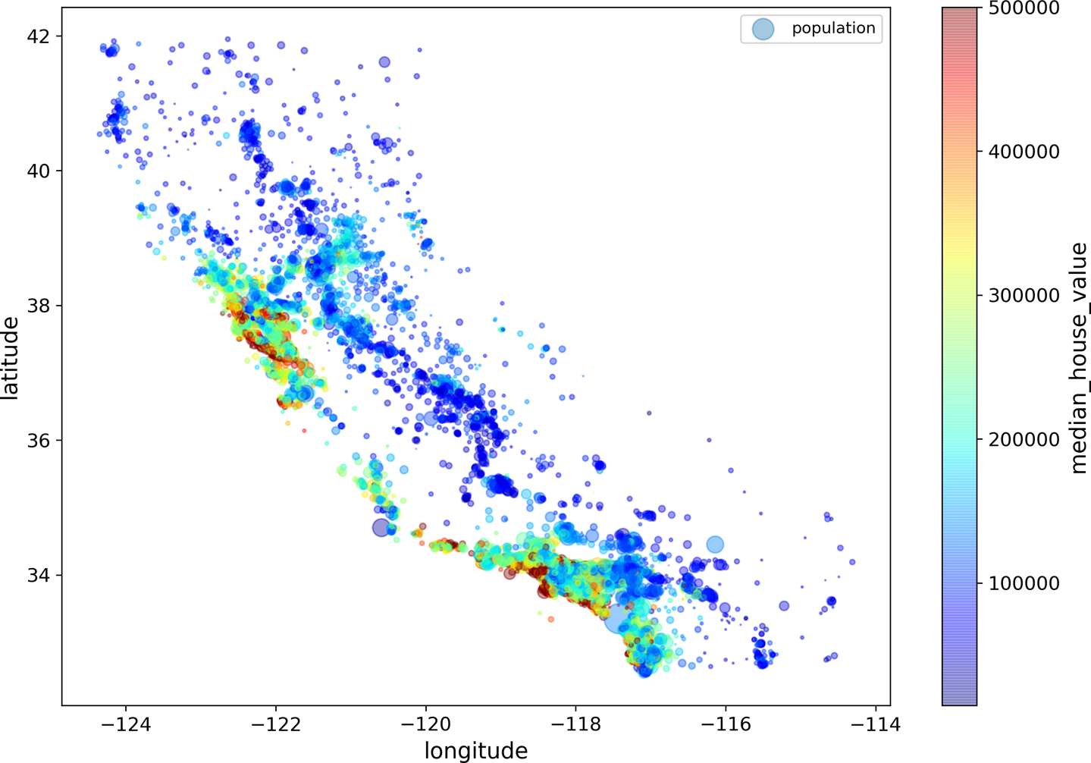
visualize
Density
Lacation

Slide 12
visualize
Correlation
corr(): compute correlation between every pair of attributes
median_house_value 1.000000
median_income 0.687170
total_rooms 0.135231
housing_median_age 0.114220
households 0.064702
total_bedrooms 0.047865
population -0.026699
longitude -0.047279
latitude -0.142826
It only measure linear correlations

Slide 13
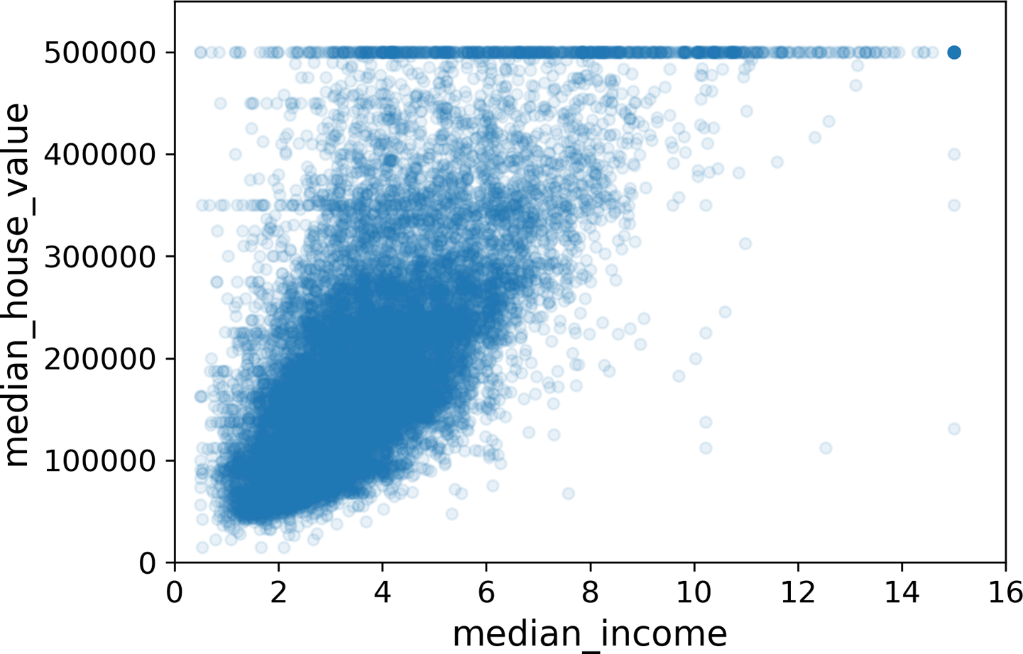
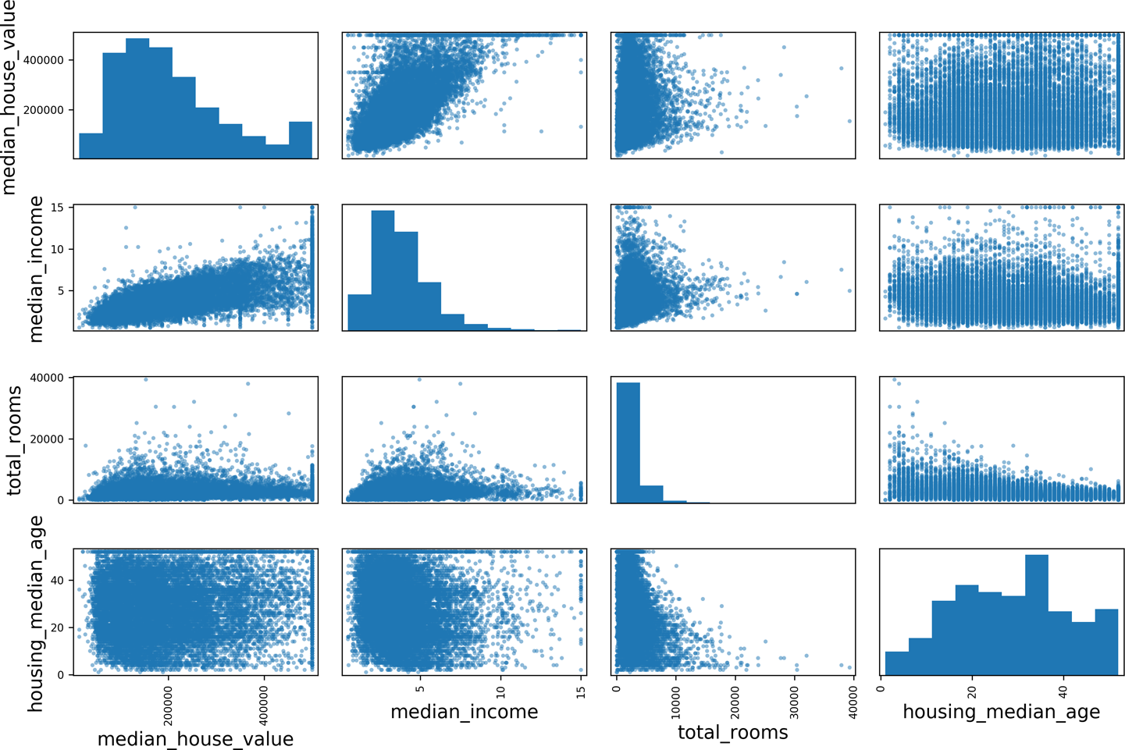
visualize
scatter_matrix(): plot every numerical attribute pair

Slide 14
visualize
Attribute Combinations
Ex) number of rooms -> rooms per household
Number of bedroom -> bedroom per room
Population per household
->correlation changed
Bedrooms per room correlation: -0.26

Slide 15

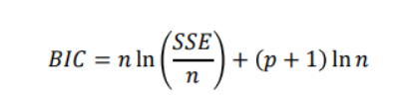
Likelihood and information Criterion
L (y value of pdf)
L(distribution|data)=likelihood
->fixed data, changing distribution, different L value
->some distribution(high likelihood) explain the data better
Model indicator(low: good)
AIC(Akaike information criterion)
Using in regression
BIC(Bayes information criteria)
Use in big dataset

